Slide 1
Focus Group
Sprout Inc

Slide 2
What is Sprout?
Sprout is a dating app that we are currently developing as a class project for COS 420 at the University of Maine.
Sprout is based around finding people who are compatible in personality, rather than based off of images.

Slide 3
What makes Sprout different?
Not able to see users photos until after matching has happened.
Rather than showing photos when matching we show icebreaker questions such as “Dogs or Cats?”

Slide 4
Who is Sprout for?
-The target group for Sprout is college students and adults in the age range 18-25.
- Sprout aims to target single people who are not interested or have not had success with hookup apps like Tinder and Bumble.

Slide 5
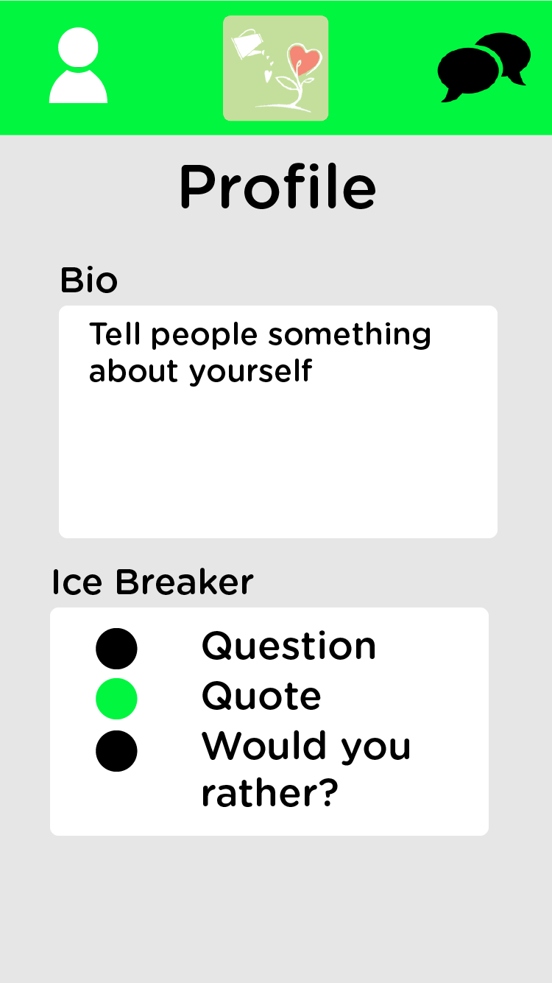
Example UI - Profile

Slide 6
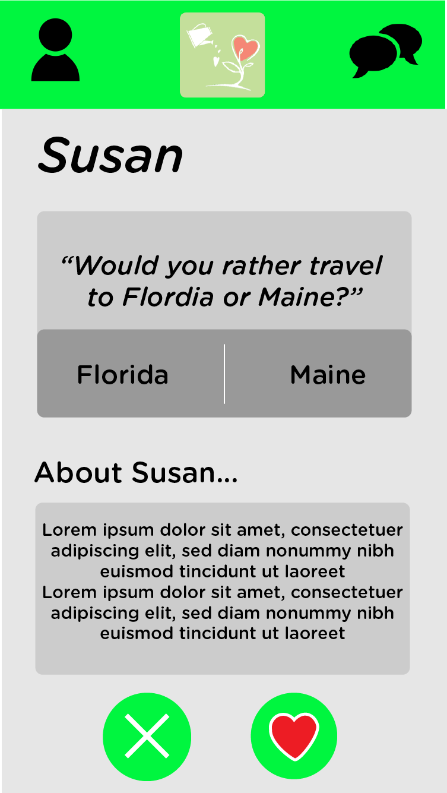
Example UI - Other Users

Slide 7
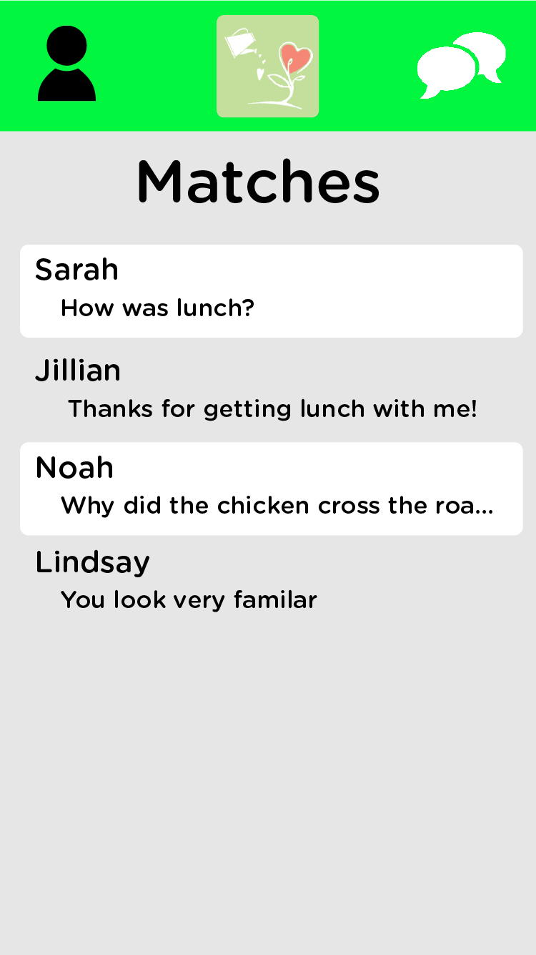
Example UI - Matches

Slide 8
What devices will Sprout work on?
Sprout will be available on both Android and iOS devices upon release.

